Slide 1
COVID-19 Management System
Dave Anderson (team leader),
Zhuojing Xie, David Nguyen​

Slide 2
CONTENTS
Overview & Our Mission
Console Demonstration
Web
Q&A

Slide 3
Problem
Since March 2020, COVID-19 has turned the United States upside down. Although there could have been more effective measures early in the pandemic, state governments now find themselves in a great need to track COVID-19's spread within local governments and analyze statistics to fight back. This includes creating testing facilities, tracking cases, and coordination with labs and hospitals to deal with the massive expected flux of patients and tests.

Slide 4
Our mission
Help health care systems properly manage and observe the ongoing COVID-19 Pandemic by providing organize statistics and information about the spreading of the virus

Slide 5
Pandemic Analysis
Inventory control
Allow State Health Dept to monitor the latest pandemic status
Help Hospital to monitor the medical supplies inventory
Hotspot warning
Case check
Warning individuals to avoid visiting high risk places
Follow up on each case to find best treatment to fight COVID-19

Slide 6
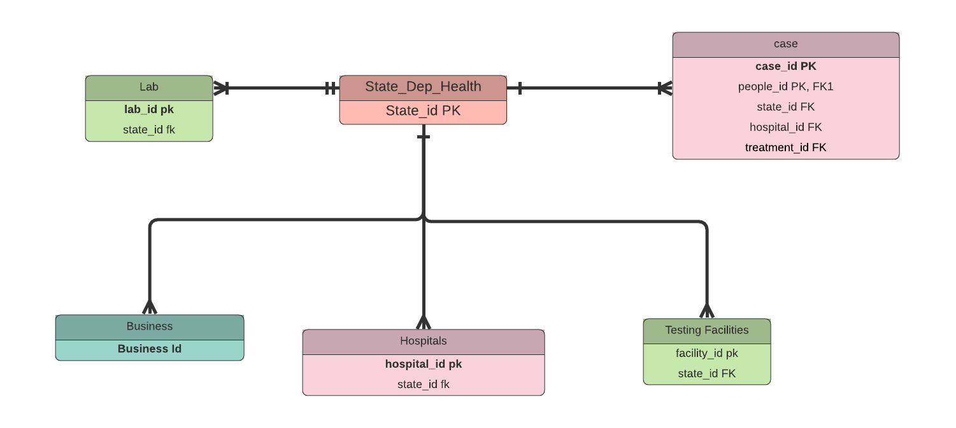
State dept of heath View
Feeds
Feeds
Warn
Overview

Slide 7
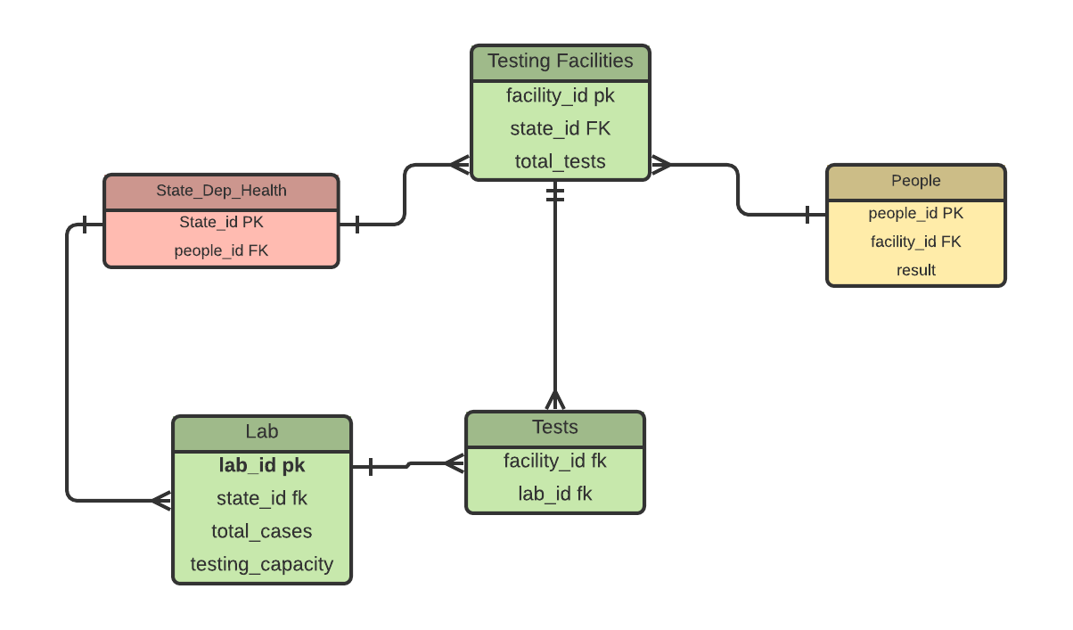
Testing Facilities View

Slide 8
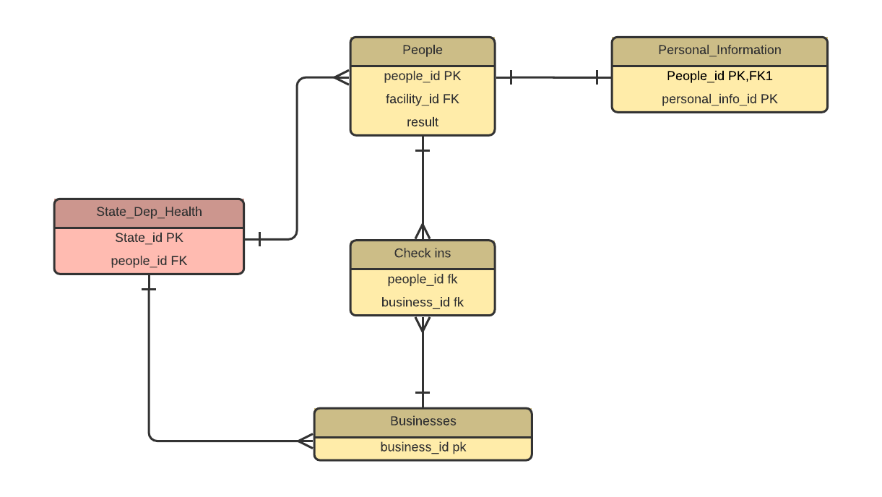
People view
SDH gives warning if people contacted infected

Slide 9
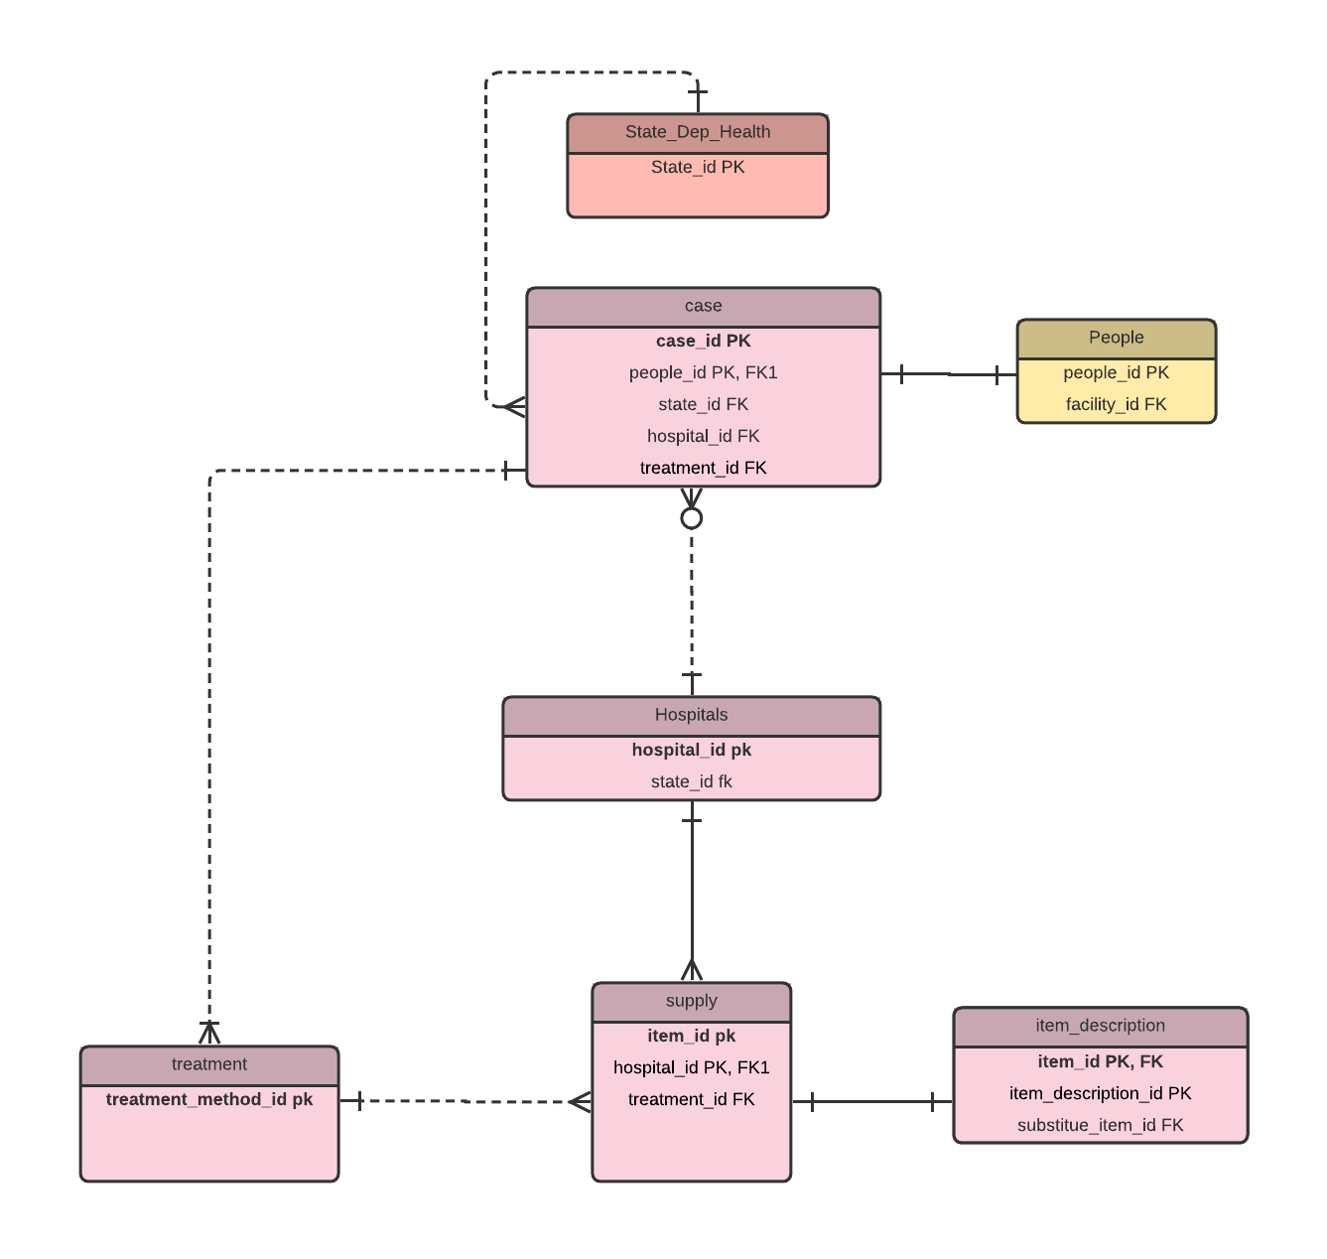
Hospital View

Slide 10
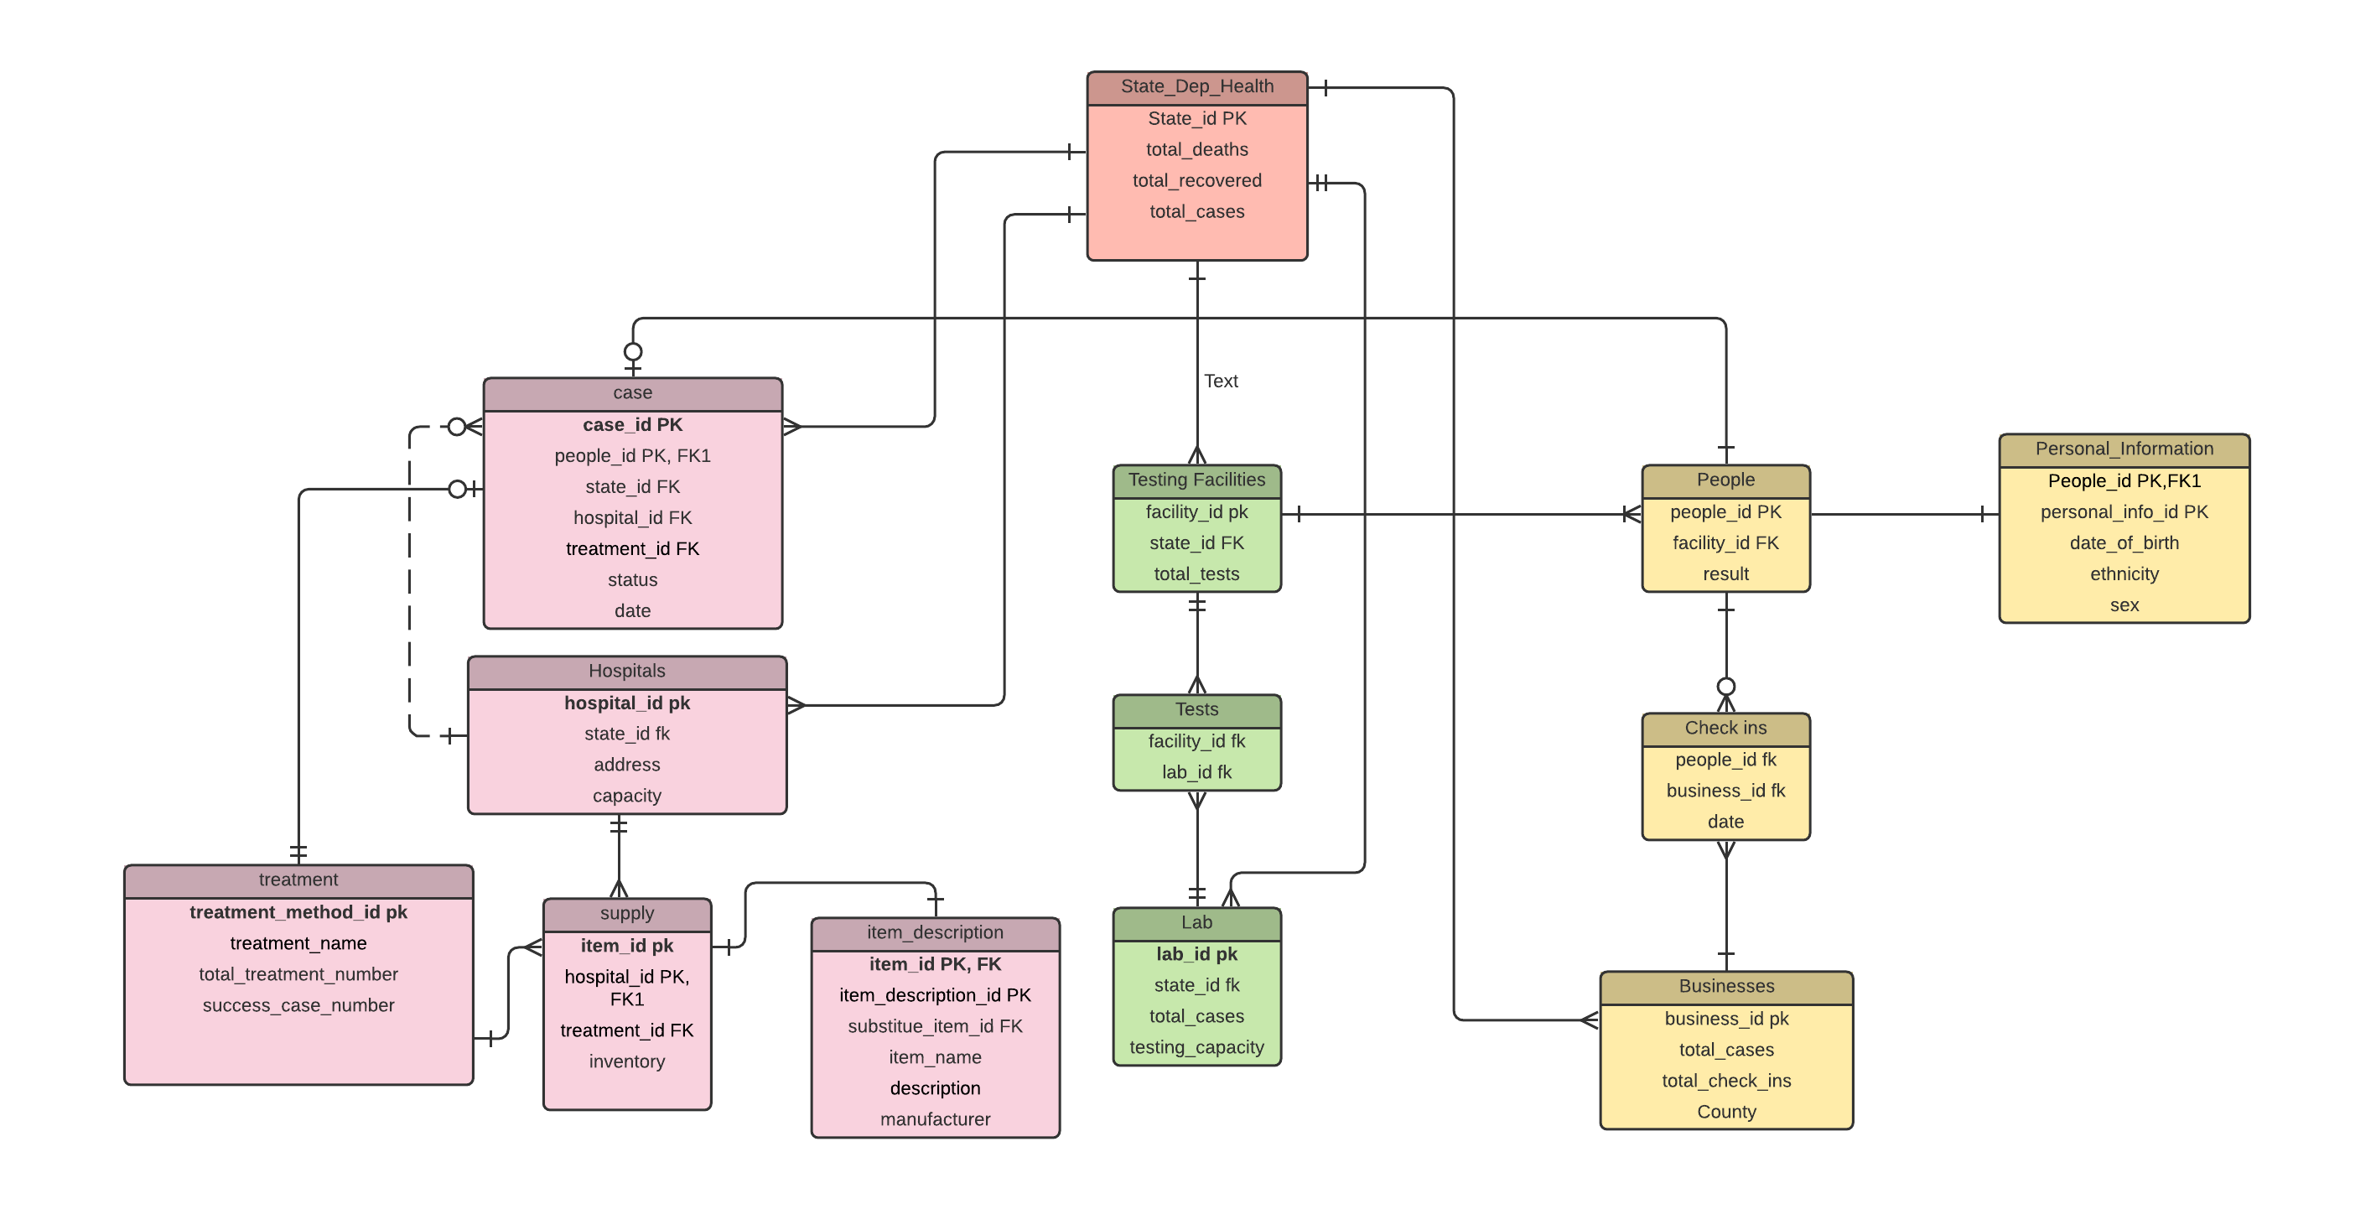
Conceptual Model

Slide 11
Q&A ?

